Slide 1
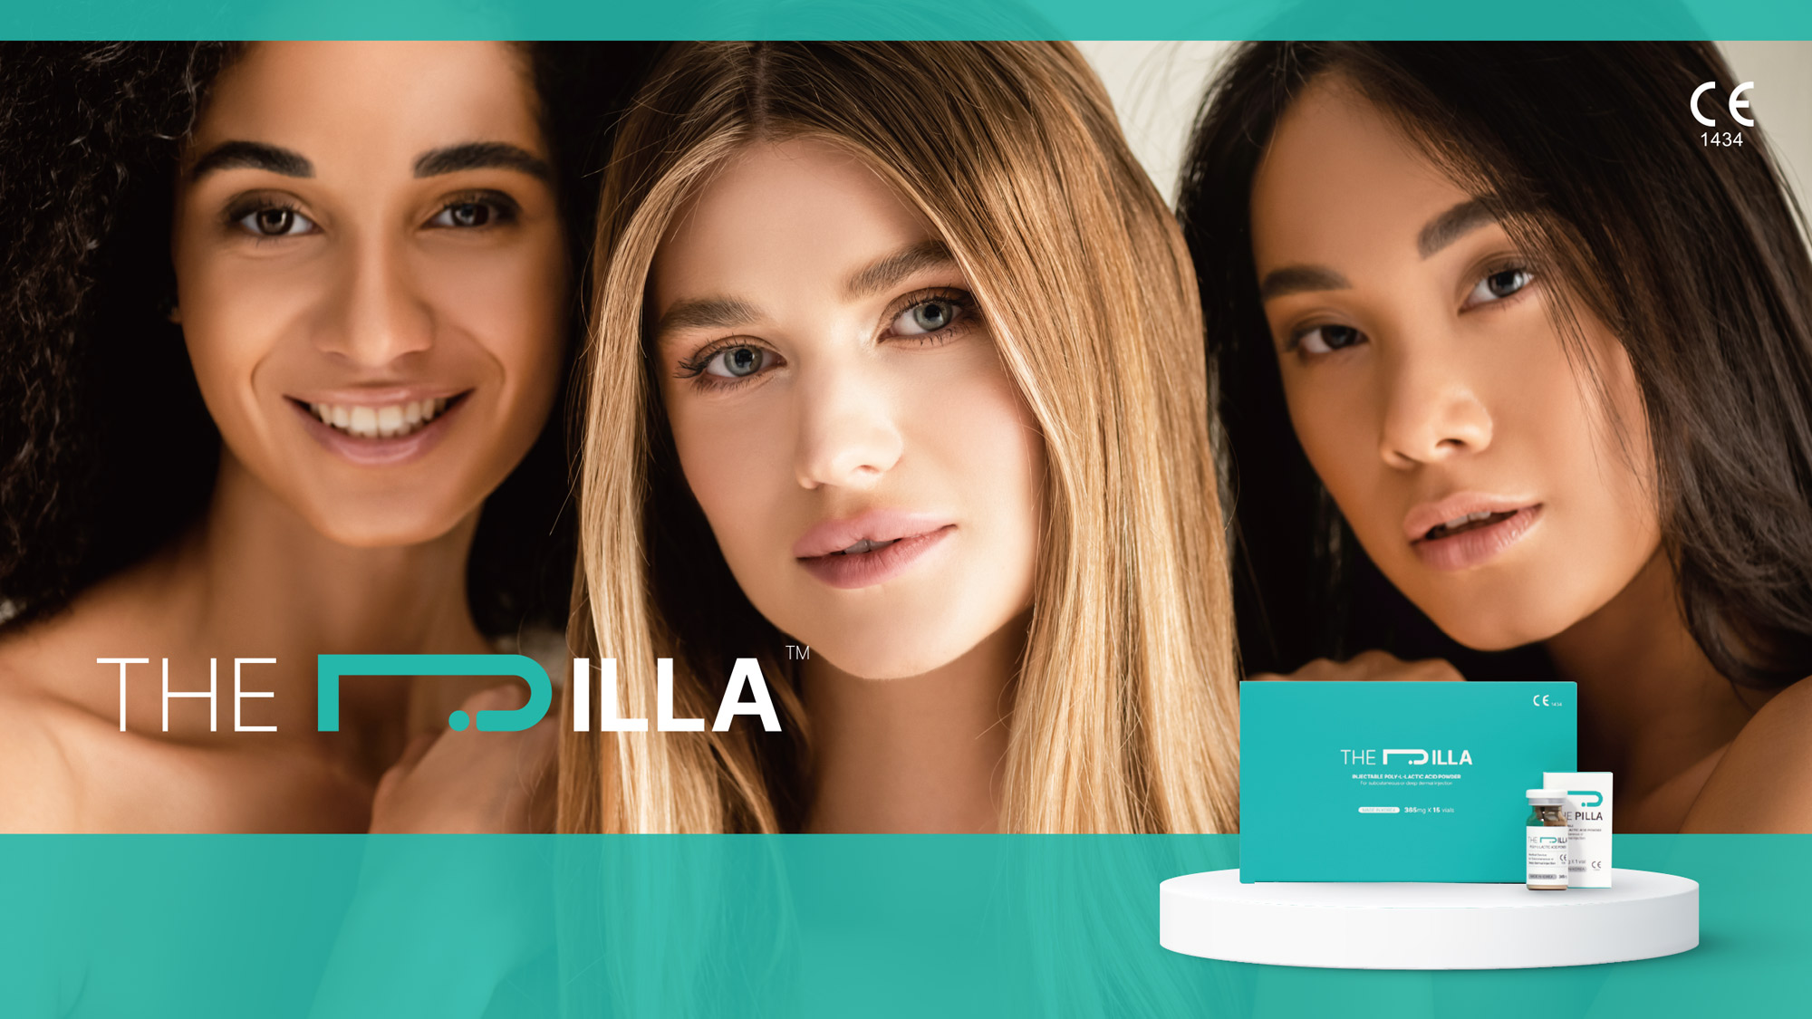
MEDICAL DEVICE
DON’T FILL, STIMULATE
STIMULATE YOUR OWN COLLAGEN
For Professionals
This product is a medical device indicated for treatment of severe facial wrinkles and folds, replacement of volume defects,
facial lipoatrophy and improvement of facial contour deformities.
Before using THE PILLATM, please read the "instructions for use" thoroughly or consult with physicians.

Slide 2

STIMULATE COLLAGEN
As a safe and effective collagen stimulator, THE PILLATM is an injectable and biocompatible medical device.
THE PILLATM helps to restore natural volume for aging skin lost collagen.
Poly L-Lactic Acid, the main ingredient is used for medical material over 20 years and confimed safety by US FDA. Injected THE PILLATM (is made up of Poly L-Lactic Acid) to subcutaneous layer starts to stimulate the body's collagen production. This increases the skin's elasticity and volume naturally and makes young looking. Depend on the condition of patient, 2 to 3 times of treatments are recommended to extend longevity of volume staying.
PLLA COLLAGEN STIMULATOR Confirmed By Korean Ministry of Food and Drug Safety (MFDS)
THE PILLATM is a collagen stimulator made of PLLA which is confirmed by FDA as a medical material.
Injected THE PILLATM stimulates and generates collagen under the skin and restores volume for facial area. It naturally helps to reduce fine line wrinkles and to look young.
THE PILLATM Product Information
Volume : 365mg x 1 vial(5ml)
Indication : For treatment of severe facial wrinkles and folds, replacement of volume defects, facial lipoatrophy and improvement of facial contour deformities.
[ Reference ]
1) Aesthetic Surgery Journal 2018, Vol 38(S1) S13-S17
2) EC certified (as of 2021-03)

Slide 3



Why
?
Natural volume with longevity
Injected Poly L-Lactic Acid (THE PILLATM) restores volume stimulating collagen in the skin layer.
Generated volume with own collagen lasts more than 2 years.
For Professionals
Convenient
Long lasting
volume
Safe
Confirmed by Korean MFDS and achieved CE mark
The main ingredient PLLA is biodegradable and biocampatible
Economic
Solution = THE PILLATM
+ WFI(Water For Injection)
+ Lidocaine
Steady treatment
over 20 years
The treatment for improving wrinkle with PLLA is being done over 20 years
Short
treatment time
2)
For Patients
Natural result
The result will be shown gradually
Long lasting
volume
Quick recovery time
With less downtime, easy to return to normal life
Economic
Less cost than other surgical treatments
Colume Improvement
&Restoration
Improvement of wrinkle through lost collagen renaturation
Short
treatment time

Slide 4
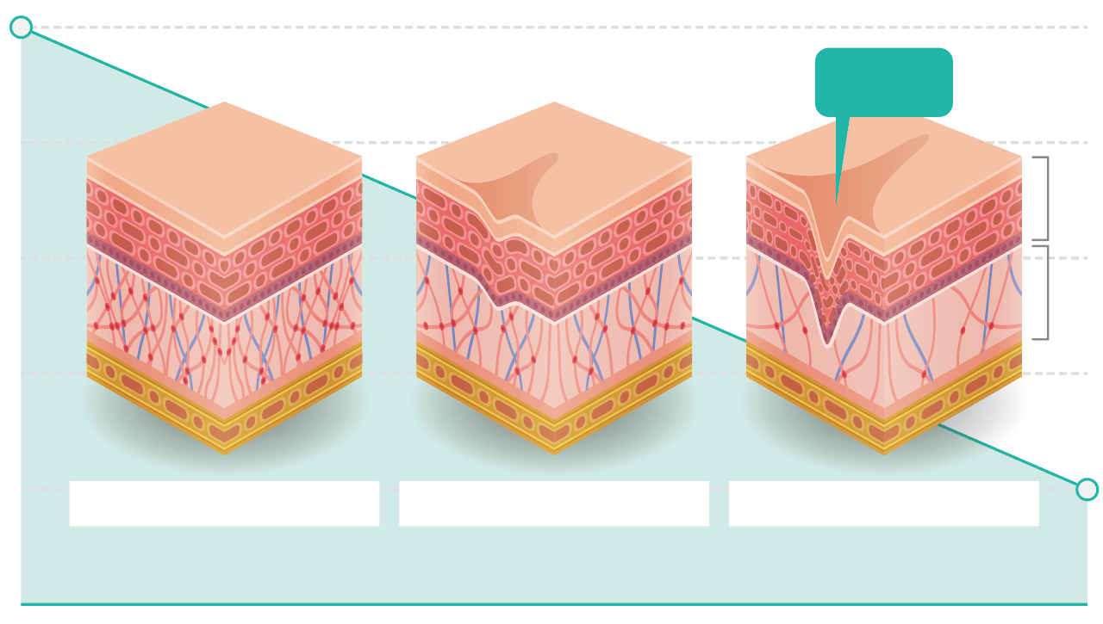
The correlation between
Collagen & Skin aging
3)
Deep
wrinkle
The proportion of the collagen types in skin change with age. Young skin is composed of 80% type I collagen and about 15% collagen type III. With age, the ability to replenish collagen naturally decreases by about 1.0% - 1.5% per year.
This decrease in collagen is one of the characteristic hallmarks associated with the appearance of fine lines and deeper wrinkles. [Picture 1]
Moreover, deep inside in the dermis, fibrillar collagens, elastin fibres and hyaluronic acid, which are the major components of the extracellular matrix, undergo distinct structural and functional changes.
Epidermis
Dermis
Collagen
High density of collagen and elastin
Degrading collagen and elastin
Lack of collagen and elastin
The loss of collagen is clearly correlated with changes to
appearance attributes which are typically referred to as fine lines and wrinkles.
Age(years)
30
40
50
60
Picture 1. Collagen content in skin tends to increase untill approximately the mid-20s. Thereafter, there is a progressive loss of collagen through the decades
[ Reference ]
3) Reilly et al. Plast Aesthet Res 2021;8:2

Slide 5

Benefits of
Hyaluronic Acid Filler vs THE PILLATM
THE PILLATM doesn’t require retouching for every 6 months but lasts over 2 years after 3 times of initial treatment. After THE PILLATM treatment, patients are able to back to ordinary daily life.
Fat graft vs THE PILLATM
THE PILLATM is a non-surgical treatment and recovery time is shorter than fat graft. due to formation of biodegradable scaffold and generation of collagensis, do not need to worry about engraftment of autologous fat.

Slide 6
Benefits of
 | THE PLLATM | HA filler | Fat graft
Surgical or non surgical | Non surgical | Non surgical | surgical
Key ingredients | Poly L-Lactic acid (biodegradable) | Hyaluronic acid (biodegradable) | Autologous fat
Treatment time | Within 10-13 mins | About 30 mins | About 2 hrs
Indication areas | Possible for both narrow, wide areas. *narrow area (nasolabial folds, nose, chin, forehead, frown, tear through, malar), *wide area(cheek, temple and etc.) | Mainly for narrow area (nasolabial folds, nose, chin, forehead, frown, tear through, malar) | Mainly for narrow area (cheek, whole face including temple)
Duration time | Over 80% maintains for 25 months. After 3-4 Initial injections, no need for additional injection for 2-3 years | Disappear during 6-8 months repearing treatments | Rapidly disappearing after a month and slows down disappearing in 1-2 years
Adverse event | Necrosis, blindness, edema | Necrosis, blindness, edema | Edema, bruise
Feature | Stimulate collagen generation | Induce collagen generation | Induce collagen generation
In general, patients may experience some degree of swelling because of the injection treatment itself. Because of this swelling, the injection sites may appear to be completely corrected immediately (within 30 minutes) after injections.
Patients should be informed that the swelling after the injection will be resolved within hours or days after injection, and that the injection sites will result in the original appearance before the injection treatment.

Slide 7
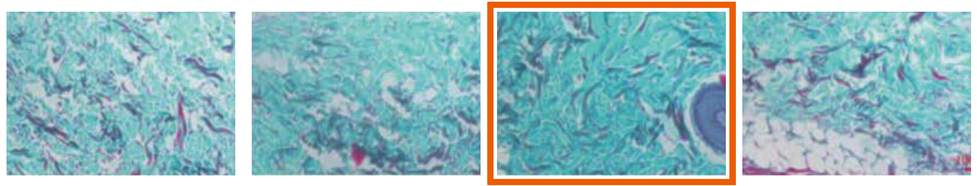
is
Superior Collagen Stimulator
4)
The collagen density of PLLA MS group is higher than others
The collagen density of PDLA MS and PDLLA MS group was significantly sparse than that of PLLA MS Group.
PLLA MS has the most obvious effect on stimulating collagen regeneration, and it is indeed suitable for usage as dermal filler in comparison with PDLA MS and PDLLA MS.
Collagen fiber, mucus and cartilage : Blue
Control
PDLA MS
PLLA MS
PDLLA MS
Picture 2. Histological analysis of collagen regeneration. Picrosirius staining of the skin at the injection site of three kinds of PLA microsphere on Day 30
[ Reference ]
4) Chinese Chemical Letters 32(2021)577-582

Slide 8
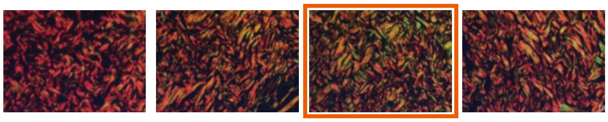
is
Superior Collagen Stimulator
PLLA form that is more effective for collagen type I and III production
Specifically, type III collagen fiber was generated in PLLA MS group which was showing green in figure.
New collagens were still much more than PDLLA MS, PDLA MS group.
Type I collagen : Red or Yellow
Type III collagen : Green
Control
PDLA MS
PLLA MS
PDLLA MS
Picture 3. Histological analysis of collagen regeneration. Masson staining of the skin at the injection site of three kinds of PLA microsphere on Day 30

Slide 9
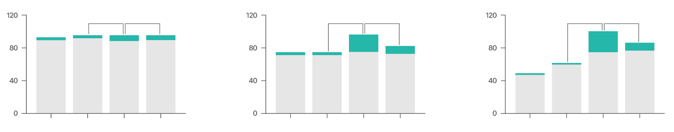
is
Superior Collagen Stimulator
Day 3
Day 7
Day 30
ns
ns
ns
ns
ns
ns
Collagen(%)
Collagen(%)
Collagen(%)
Control
PDLA MS
PLLA MS
PDLLA MS
Control
PDLA MS
PLLA MS
PDLLA MS
Control
PDLA MS
PLLA MS
PDLLA MS
Table 1. Semi-quantitative analyses of type I and type III collagen fibers. Data are presented as mean standard deviation (n = 3;*P < 0.05, **P < 0.01, ***P < 0.001, ns: not significant)

Slide 10
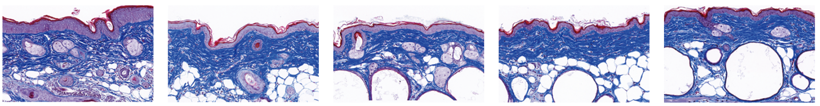
is
Superior Collagen Stimulator
Collagen production effect of THE PILLATM
According to MT staining results, it was confirmed that collagen was produced in both the test group THE PILLATM and the company A product compared to the control after filler injection.
0 day
12 weeks
24 weeks
36 weeks
48 weeks
MT stain
(X200)
Picture 4. Collagen production over time after injecting THE PILLATM, MT stain(x200)

Slide 11
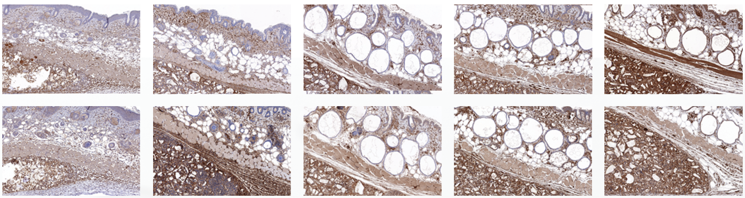
is
Superior Collagen Stimulator
Collagen production effect of THE PILLATM
According to IHC results, it was confirmed that collagen type Ⅰ and collagen type Ⅲ expression increased compared to control after THE PILLATM injection.
IHC-Collagen
type I (X100)
IHC-Collagen
type III (X100)
Picture 5. The expression of collagen type Ⅰ and collagen type Ⅲ over time after injecting THE PILLATM, IHC(x100)

Slide 12
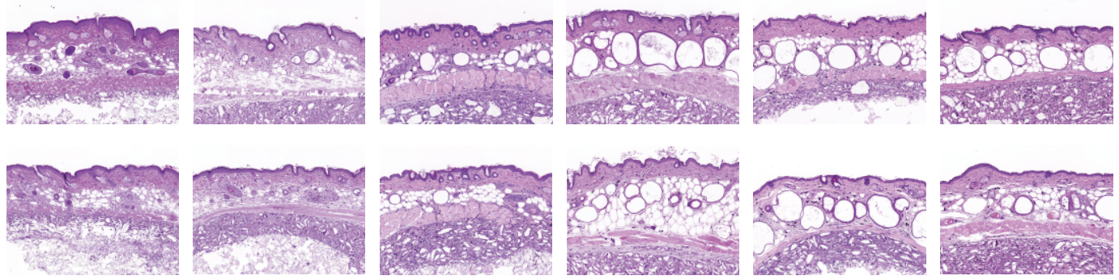
is safe
Safety of ingredients against foreign substances and inflammatory reactions
According to histopathological evaluation results, fibroblasts migrate and proliferate between microparticles in both THE PILLATM and Company A products from immediately after injection to 48 weeks. Multiple nuclei were observed and were read to improve from the inflammation degree of moderate (score 2) to the inflammation degree of mild (score 1) after week 4.
The inflammatory and foreign body reactions of THE PILLATM were equally or safely read compared to the licensed product of Company A.
0 day
4 weeks
12 weeks
24 weeks
36 weeks
48 weeks
THE PILLATM
Product of
Company A
Picture 6. After injecting THE PILLATM and company A product(bottom), check foreign substances and inflammatory response over time – H&E staining(x100)

Slide 13
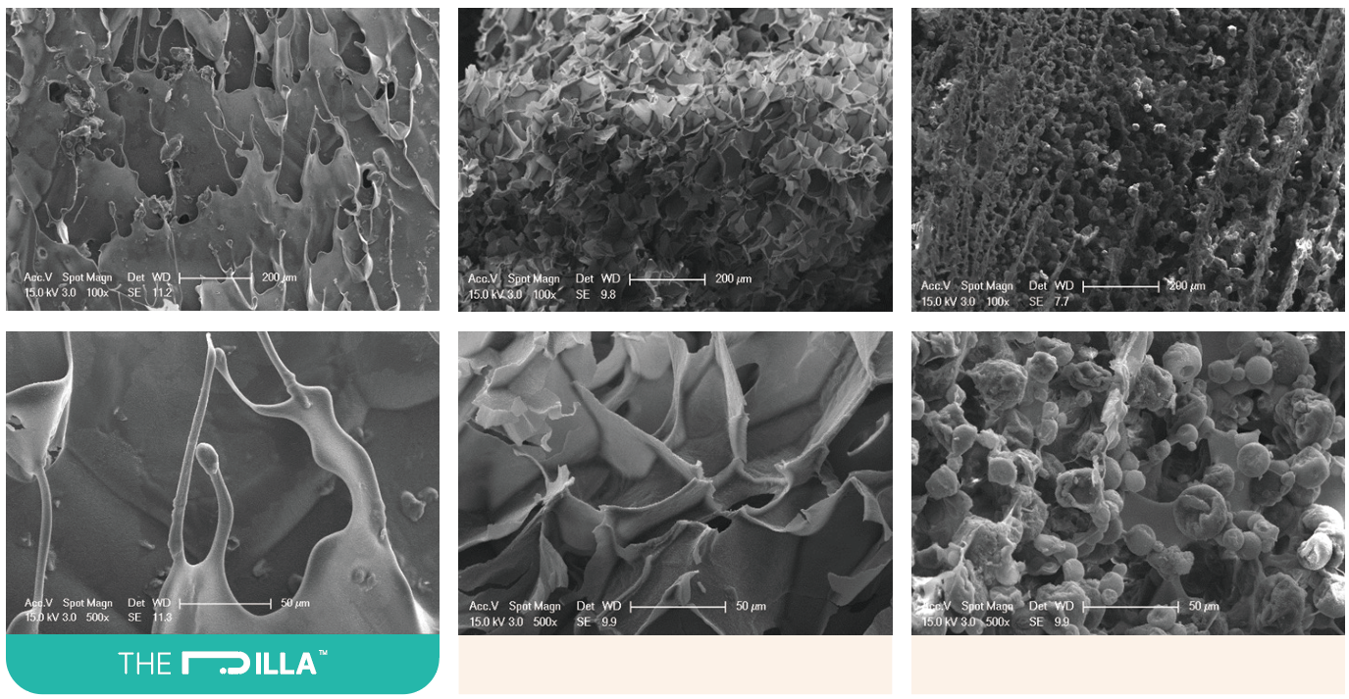
is safe
Particle Shape
THE PILLATM is Soft PLLA with a soft particle shape.
The shape of the THE PILLATM Granule powder is smooth and streamlined to reduce side effects.
Picture 7.
SEM Microscopic photography, solution form
Company A
Company B

Slide 14
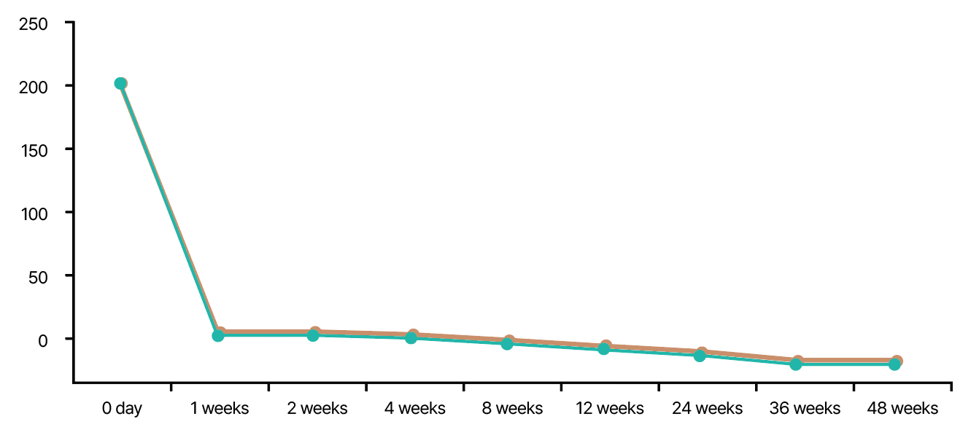


is safe
Biodegradability
THE PILLATM showed a tendency to decrease gradually by week 36 after a sharp decrease in initial volume in week 1.
The initial volume reduction is due to the absorption of the excipient in vivo, and the licensed product. Company A, and THE PILLATM, tend to be equivalent.
The experiments of THE PILLATM and control group A
showed almost the same results.
Volumetric analysis :
PRIMOS LITE Topography
Software (mm³)
Picture 8. ARelative volume change after THE PILLATM injection

Slide 15
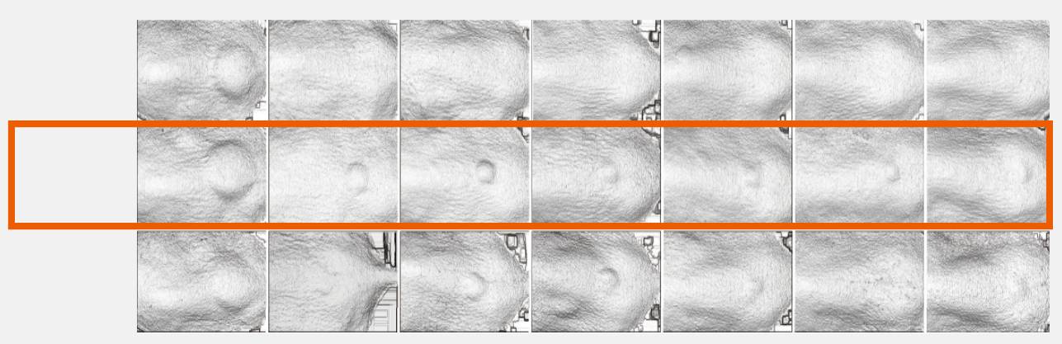
is safe
0 day
1 weeks
2 weeks
4 weeks
8 weeks
12 weeks
24 weeks
PBS
THE PILLATM
Company A
Picture 9. The change of initial filler volume; Volumetric analysis; PRIMOSLITE Topography (with Software PRIMOS 5.8) Clinical study of Jungang University Korea

Slide 16
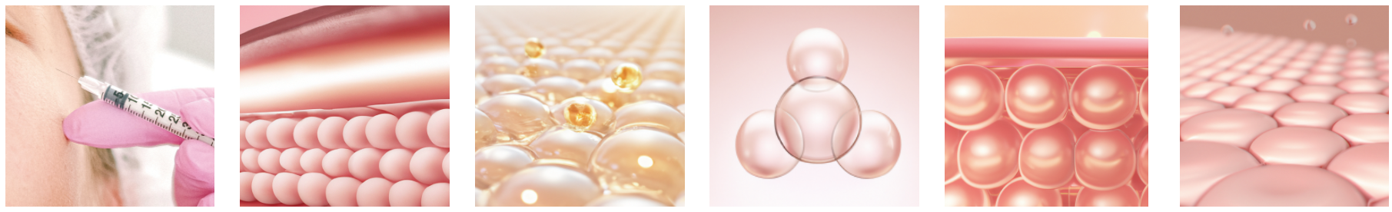
How works
5)
PLLA(Poly L-Lactic Acid), the main ingredient of THE PILLATM is biocompatible and biodegradable synthetic polymer that been used for sutures and other medical device.
njected PLLA stimulates collagen generation, the volume gradually restored improves wrinkles.
Mechanism of action
SETP 01
Inject diluted THE PILLATM into the subcutaneous layer of the skin.
SETP 02
Firstly wrinkle improvement can be shown with WFI(Water for injection) and diluted THE PILLATM
SETP 03
Within a few days, after absorbing water, only
THE PILLATM particles left.
SETP 04
New cells are gathered around THE PILLATM particles and increasing
fibroblasts.
SETP 05
Increased fibroblasts stimulate collagen generation and improve skin folds.
SETP 06
Generated collagen lasts for 2 years and THE PILLATM particles are biodegraded.
[ Reference ]
5) Facial Plast Surg.2009:25:95-99

Slide 17
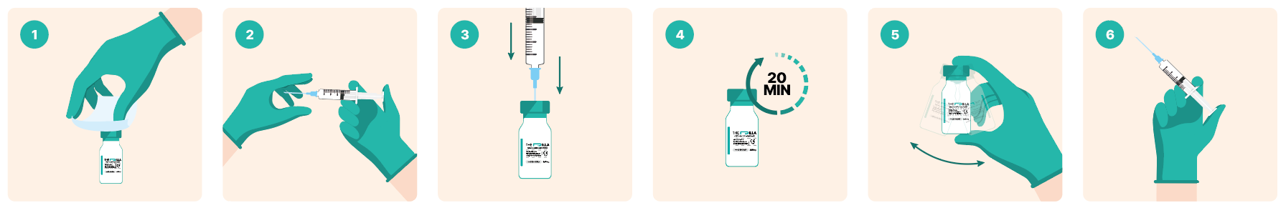
Procedure
Remove the lid of the vial and wipe the rubber stopper of the vial with an antiseptic.
To produce suspension, connect 18G sterile needle to a 5ml sterile, single use syringe.
After taking the injection water with a 5ml syringe, insert the 18G injection needle into the rubber stopper of the vial at once and slowly inject the entire injection water into the vial containing freeze-dried powder.
Shake slowly for the first 5 minutes, then leave the powder unshaken for about 20 minutes to completely hydrate, and check the hydration condition.
When you are ready to inject the product into the patient, gently shake the vial to mix into a homogeneous translucent suspension. ※ The preparation solution should be injected into the patient within 72 hours of preparation, and unused preparation solution should be discarded within 72 hours.
Each time a patient is treated, wipe the rubber stopper of the vial with an antiseptic and use an 18 G sterile needle connected to 1 or 3ml disposable sterile syringe, to withdraw an adequate amount of suspension from the vial. At the time of treatment, use a 23G~26G sterile needle or sterile cannula depeding on the case- by- case treatment purpose. ※ Do not store the dispensing solution in a syringe.
Preparation TIP!
Due to the nature of the PLLA, it is recommended to perform the procedure as soon as possible due to rapid sedimentation in the syringe.
Dilution of non-cl HA by 1 to 2 cc instead of injection water can slow the rate of precipitation.

Slide 18


Applications
Face
Forehead
Temple
Tear trough
Cheek
Nasolabial fold
Perioral wrinkle
Marrionette line
Neck line
Back of hand

Slide 19


Applications
Body
Neck
Upper arm
Abdomen
Buttock
Virginal part
Inner thigh

Slide 20

After Care
1. 5.5.5. Massage
After the treatments, massage 5 times a day for 5 minutes for 5 days.
2. Cooling pack
Using an ice pack to cool the treatment area helps reduce swelling and heat sensation.
※ However, avoid direct contact with the skin of the ice pack.
3. Things to avoid
Avoid drinking alcohol and smoking for 2~3 day.
4. Avoid sunlight
Do not exposure your skin to intense direct sunlight.
Number of treatments and dosage
Number of treatments
About three times on average
Interval
4~6 weeks
Usage per session
1~3 vials

Slide 21
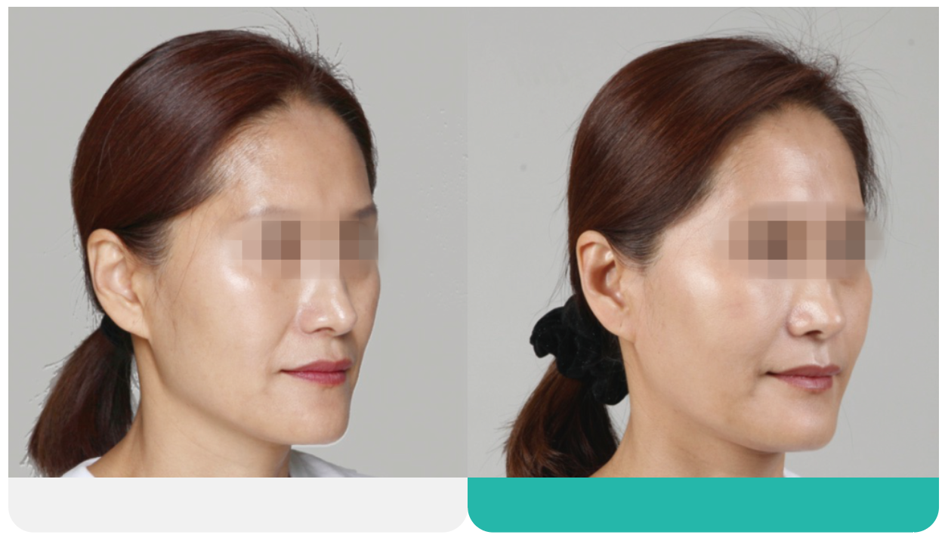
Before & After
Before
After

Slide 22
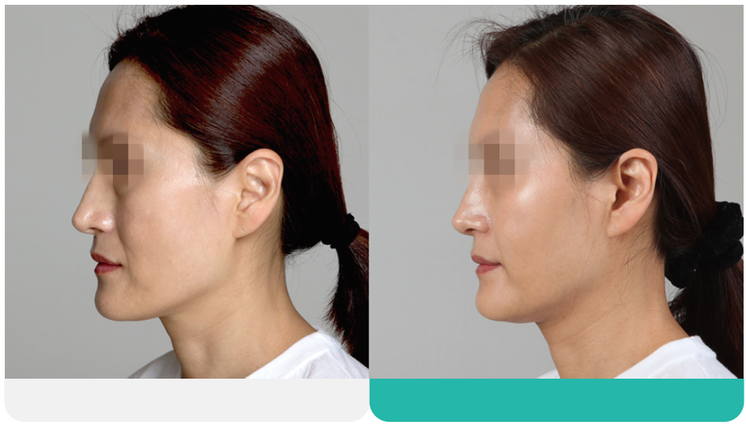
Before & After
Before
After

Slide 23
Before & After
Before
After
Before
After

Slide 24
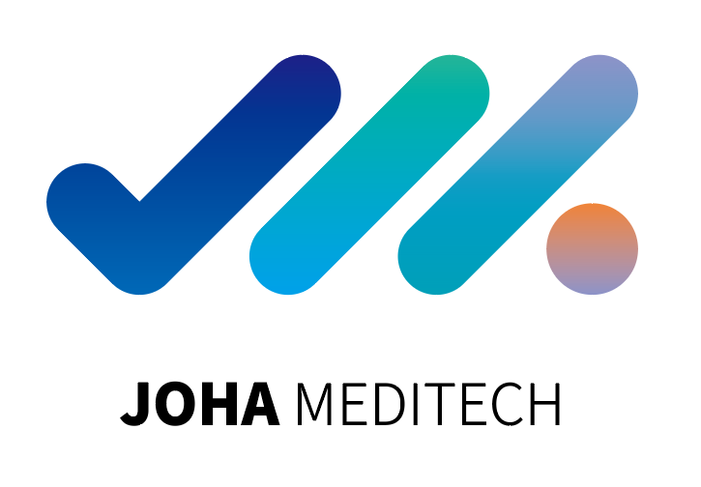

JOHA MEDITECH Co., Ltd.
HQ. 10th Floor., 209 Bongeunsa-ro, Gangnam-gu, Seoul, 06109, South Korea
BR. W-1205(Hyundai Terrace Tower), 7 Yeonmujang5ga-gil, Sungdong-gu, Seoul, 04782, South Korea
T. +82 2 2223 2129
F. +82 2 2223 2130
E. info@joha.co.kr
W. www.thepilla.com | www.joha.co.kr

